Slide 1
Keywords

Slide 2
KEYWORDS
A flat file containing claims data that is loaded into Facets
An ETL process that takes claims data from EDINET Staging tables and puts them into Facets proprietary format (TriZetto format)
Keyword files do not include rejected claims from the 837 files.
Keywords are generated from EDINETCLAIM_PROCESS database on EDINET1P and loaded to FACETS through the XC00 Batch job and CLMU loads.
To check for the number of keywords generated for New Day claims, click on the "Keyword Status" page in the T837/CIRT (PEGA) Dashboard.
To monitor the keywords that have generated and the keyword currently generating, go to this file path:
\\va01pstodfs003.corp.agp.ads\apps\Facets\Prod\TZG\Files\GBFAC01P\INBOUND\KWD\CLAIMS\INPUT

Slide 3
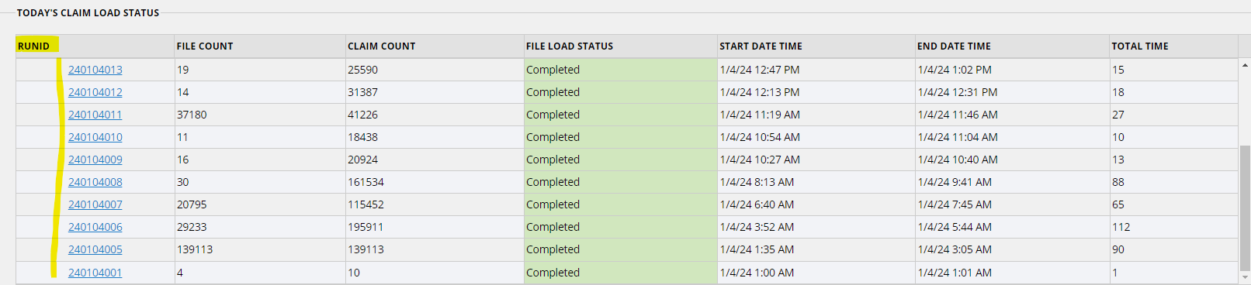
Keywords
When 837 files are loaded to EDINET, they are assigned a Run ID:
When a Run ID completes, it triggers the next part of CLA303D (or CLA303E if running) to drop the ClaimsProcess.done flag file.
When this happens, that flag file tells the system that claims processing for this run is COMPLETE. Proceed with generating a keyword for that specific Run ID (CLA305C, A, B) and start a new load to PEGA (CLA303D).

Slide 4
CLA305C & CLA305A – New Day Keywords
These are the jobs that kick off Informatica processes which generate the New Day keywords.
CLA305C – First New Day Keyword Job
Responsible for generating New Day claims
Starts between 1:30 AM – 6:45 AM
Runs in Informatica
Depends on CLA303A = Completed Normally
CLA305A – New Day Keyword, runs throughout the day
Responsible for generating New Day keywords
Starts between 7:00 AM – 11:30 PM
Runs in Informatica
Depends on CLA305B = Completed Normally

Slide 5
CLA305B – Recycle Keyword & CLA305D – Adhoc Keyword
CLA305B
This Tidal job is responsible for kicking off the Informatica process to generate the keyword for recycle claims.
Time dependency of 6:00AM – 8:30AM
Runs in Informatica
CLA305D
Sometimes, we have a need to generate a keyword from a previous day or fix a New Day keyword.
In this case, COPS SME will request this job be inserted into the current day's schedule.
Runs in Informatica

Slide 6
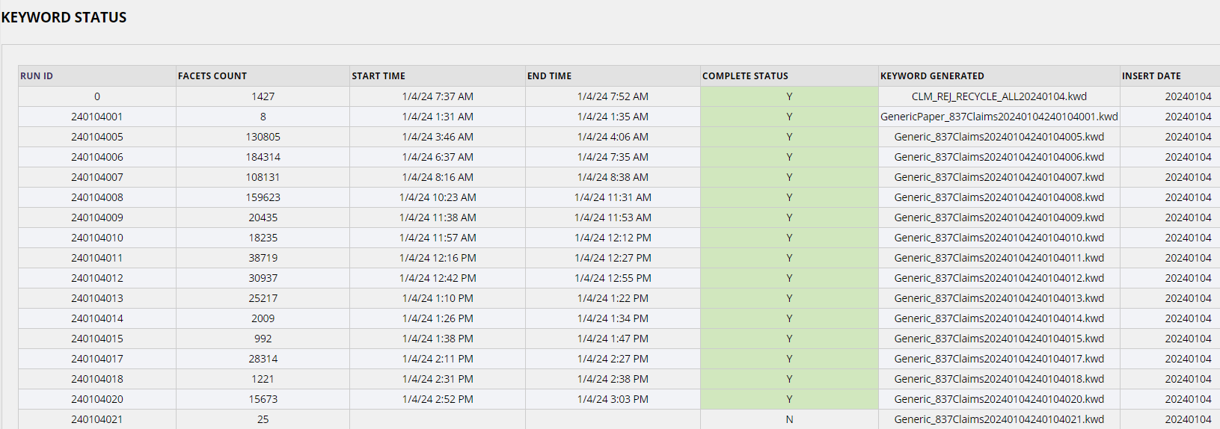
Keyword Status
Keywords will have RunIDs that match the ones on the Dashboard.
Facets Count = Claims Count
The file name of the Keyword file
Status of the keyword

Slide 7
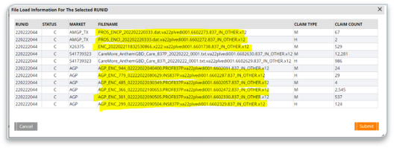

Keywords
The last keyword for the day is the Encounters keyword.
Once CLA303E is complete, select the last few RunIDs on the Dashboard.
When you see an ENC file, you know that is the RunID for the last keyword that will generate
RunID 0 is the RunID generated for the recycle claims
This is generated by CLA305B

Slide 8
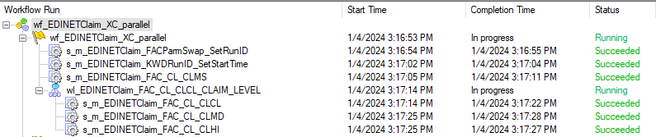
Informatica Workflow
While you can check the status of the keyword on the Keyword Status page, it's also important to monitor how the keyword workflow is progressing.
REPO_GBD_PROD_CLAIMS > IS_GBD_CLAIMS > CS_KWD > wf_EDINETClaim_XC_parallel
This workflow should never run longer than 60 minutes (regardless of how big the keyword is, meaning how many claims are included in the keyword).
If long running sessions are identified, be sure to check Precise. For more information, reach out to more seasoned members on Atlas Ops.

